Slide 1
Dynamic Programming –
Matrix chain Product
Algorithms & Data Structures
ITCS 6114/8114
Dr. Dewan Tanvir Ahmed
Department of Computer Science
University of North Carolina at Charlotte

Slide 2
Dynamic Programming

Slide 3
Outline and Reading
Matrix Chain-Product (§5.3.1)
The General Technique (§5.3.2)

Slide 4
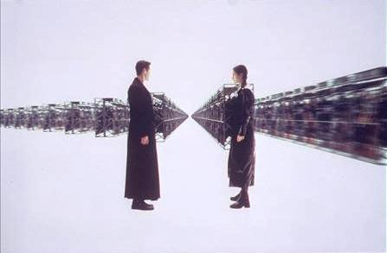
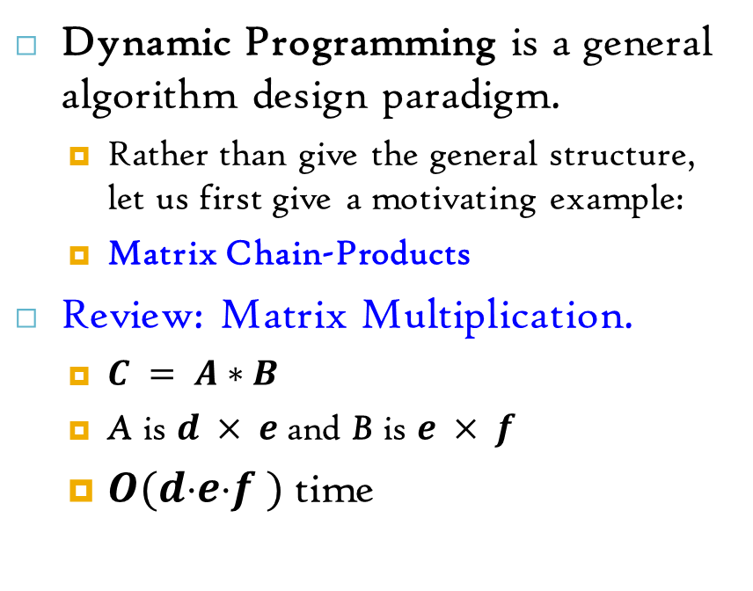
Matrix Chain-Products
Dynamic Programming is a general algorithm design paradigm.
Rather than give the general structure, let us first give a motivating example:
Matrix Chain-Products
Review: Matrix Multiplication.
$C = A∗B$
A is $d × e$and B is $e × f$
$O(def )$time
f
B
j
e
e
A
C
d
i
i,j
d
f

Slide 5
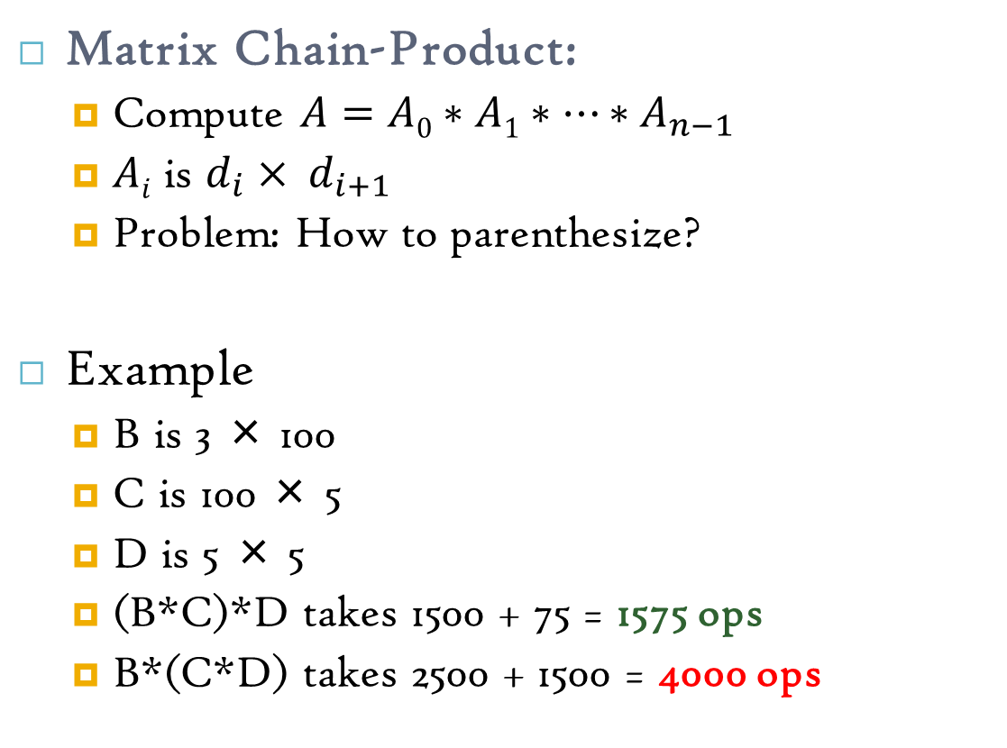
Matrix Chain-Products
Matrix Chain-Product:
Compute $A=A0∗A1∗…∗A_{n−1}$
$Ai$ is $d_{i}× d_{i+1}$
Problem: How to parenthesize?
Example
B is 3 × 100
C is 100 × 5
D is 5 × 5
(B*C)*D takes 1500 + 75 = 1575 ops
B*(C*D) takes 2500 + 1500 = 4000 ops

Slide 6
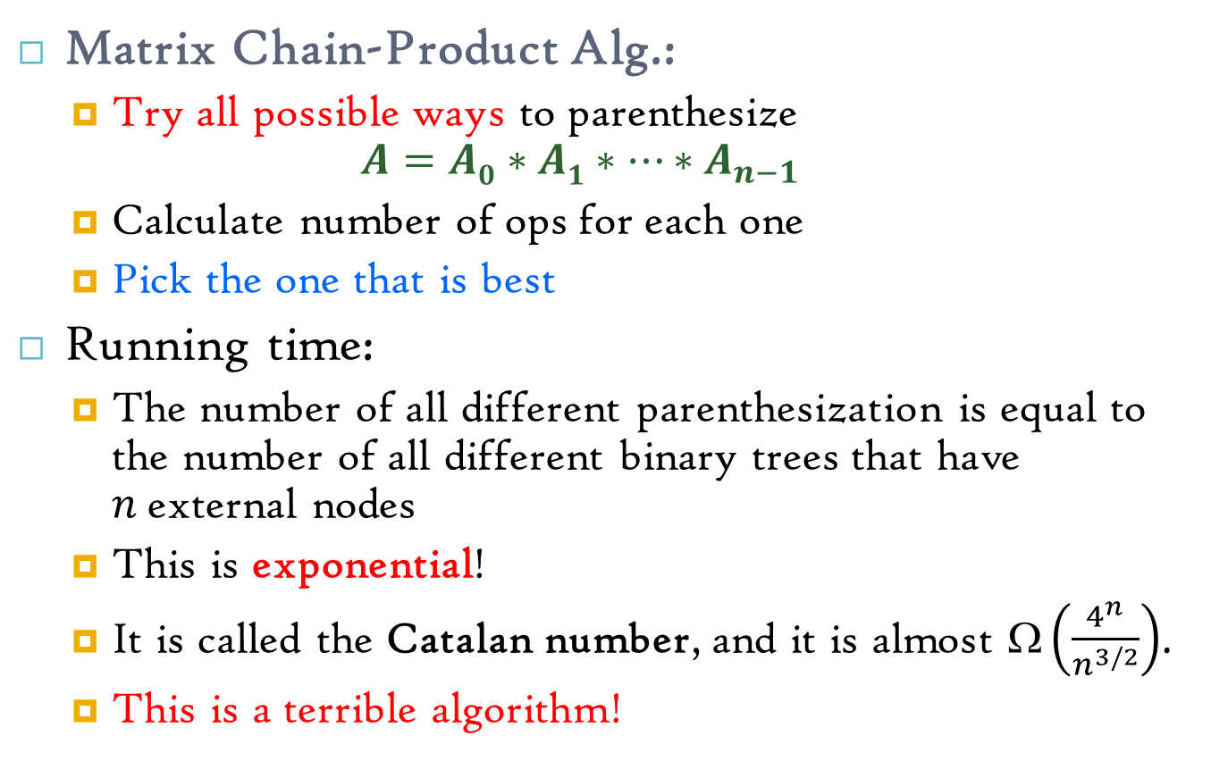
Enumeration Approach
Matrix Chain-Product Alg.:
Try all possible ways to parenthesize
$$A=A0∗A1∗…∗A_{n−1}$$
Calculate number of ops for each one
Pick the one that is best
Running time:
The number of all different parenthesization is equal to the number of all different binary trees that have $n$external nodes
This is exponential!
It is called the Catalan number, and it is almost $\left(\frac{4^{n}}{n^{3/2}}\right)$.
This is a terrible algorithm!

Slide 7
Greedy Approach
Idea #1: Repeatedly select the product that uses the most operations.
Counter-example:
A is 10 × 5
B is 5 × 10
C is 10 × 5
D is 5 × 10
Greedy idea #1 gives (A*B)*(C*D), which takes
500 + 500 +1000= 2000 ops
But: A*((B*C)*D) takes 250 + 250 + 500 = 1000 ops

Slide 8
Another Greedy Approach
Idea #2: Repeatedly select the product that uses the fewest operations.
Counter-example:
A is 101 × 11
B is 11 × 9
C is 9 × 100
D is 100 × 99
Greedy idea #2 gives A*((B*C)*D)), which takes 9900+108900+109989=228789 ops
(A*B)*(C*D) takes 9999+89100+89991=189090 ops
The greedy approach is not giving us the optimal value.

Slide 9

“Recursive” Approach
Define subproblems:
Find the best parenthesization of
$Ai∗A_{i+1}∗…∗Aj$.
Let${ N}_{i,j}$ = the number of operations for this subproblem.
${ N}_{0,n−1}=$The optimal solution for the whole problem

Slide 10
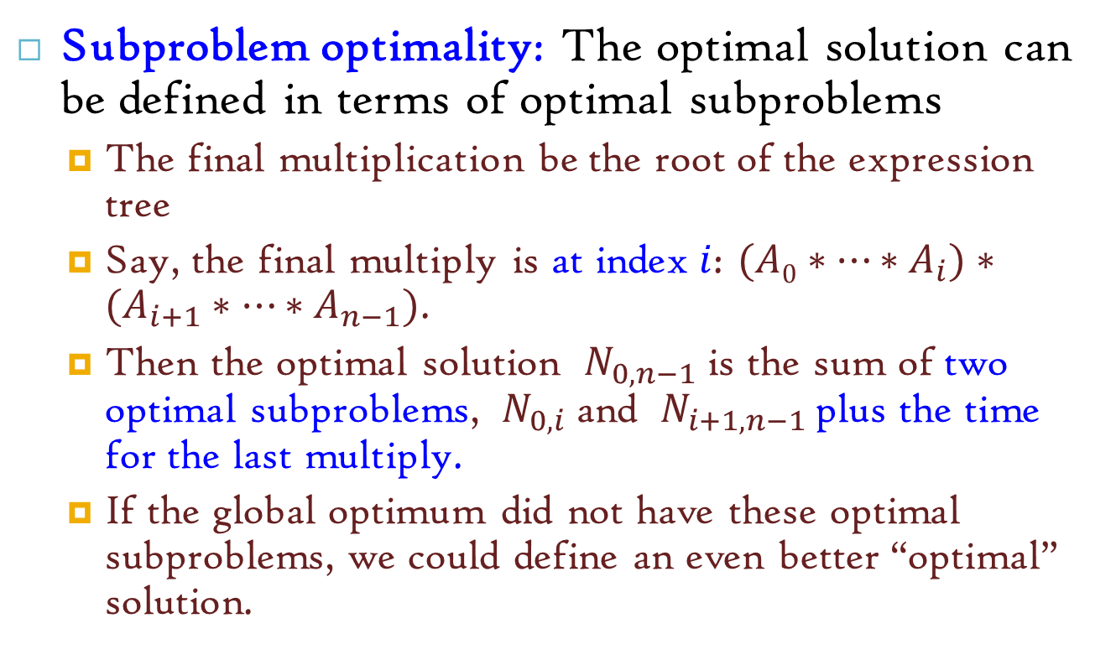
“Recursive” Approach
Subproblem optimality: The optimal solution can be defined in terms of optimal subproblems
The final multiplication be the root of the expression tree
Say, the final multiply is at index$i$: $(A0∗…∗A_{i})∗(A_{i+1}∗…∗A_{n−1})$.
Then the optimal solution ${ N}_{0,n−1}$ is the sum of two optimal subproblems, ${ N}_{0,i}$ and ${ N}_{i+1,n−1}$ plus the time for the last multiply.
If the global optimum did not have these optimal subproblems, we could define an even better “optimal” solution.

Slide 11
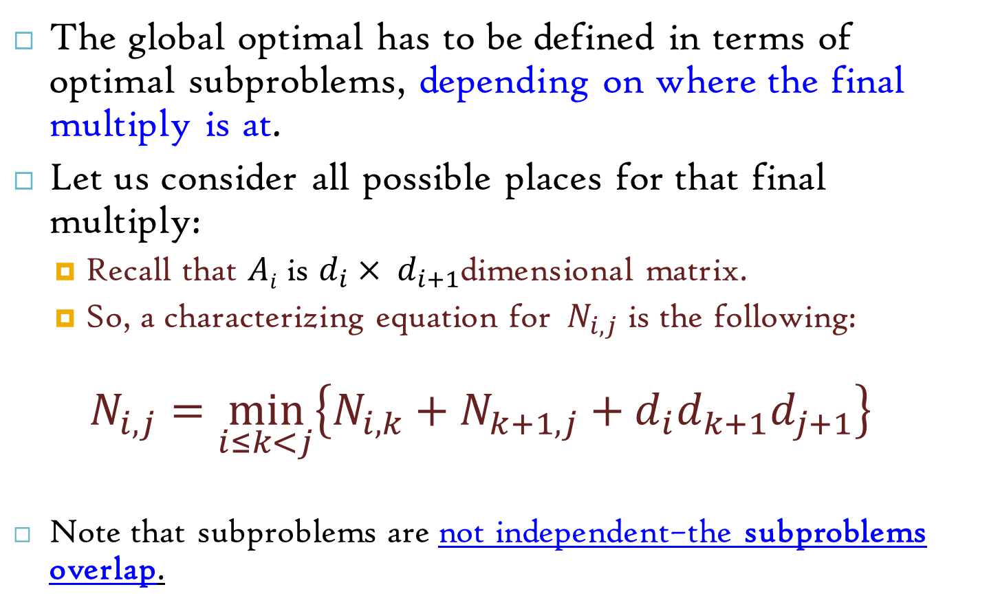
Characterizing Equation
The global optimal has to be defined in terms of optimal subproblems, depending on where the final multiply is at.
Let us consider all possible places for that final multiply:
Recall that $Ai$ is $d_{i}× d_{i+1}$dimensional matrix.
So, a characterizing equation for ${ N}_{i,j}$ is the following:
$$N_{i,j}=\min_{i≤k<j}\left\{N_{i,k}+N_{k+1,j}+d_{i}d_{k+1}d_{j+1}\right\}$$
Note that subproblems are not independent–the subproblems overlap.

Slide 12
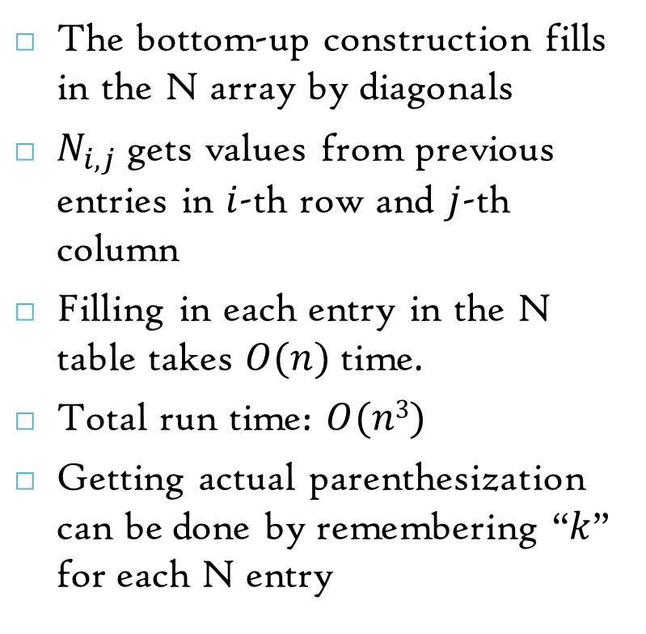
Dynamic Programming Algorithm Visualization
The bottom-up construction fills in the N array by diagonals
$N_{i,j}$ gets values from previous entries in $i$-th row and $j$-th column
Filling in each entry in the N table takes $O(n)$ time.
Total run time: $O(n3)$
Getting actual parenthesization can be done by remembering “$k$” for each N entry
N
0
1
2
i
j
…
n-1
0
1
…
answer
i
j
n-1

Slide 13
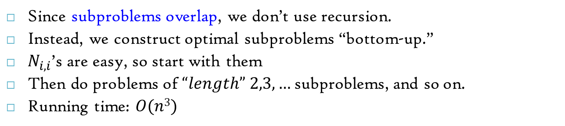
Dynamic Programming Algorithm
Since subproblems overlap, we don’t use recursion.
Instead, we construct optimal subproblems “bottom-up.”
$N_{i,i}$’s are easy, so start with them
Then do problems of $“length” 2,3,…$subproblems, and so on.
Running time: $O(n3)$
I prefer the code given in the next slide
Algorithm matrixChain(S):
Input: sequence S of n matrices to be multiplied
Output: number of operations in an optimal parenthesization of S
for i ← 0 to n - 1 do
N_{i,i} ← 0
for b ← 1 to n - 1 do
{ b = j - i is the length of the problem }
for i ← 0 to n - b - 1 do
j ← i + b
N_{i,j} ← +∞
for k ← i to j - 1 do
N_{i,j} ← min{N_{i,j}, N_{i,k} + N_{k+1,j} + d_{i} d_{k+1} d_{j+1}}
return N_{0,n-1}

Slide 14
Input: Array p[0…n] containing matrix dimensions and n
Result: Minimum-cost table m and split table s
MATRIX-CHAIN-ORDER(p[ ], n)
for i ← 1 to n
m[i, i] ← 0
for l ← 2 to n
for i ← 1 to n-l+1
j ← i+l-1
m[i, j] ← ∞
for k ← i to j-1
q ← m[i, k] + m[k+1, j] + p[i-1] p[k] p[j]
if q < m[i, j]
m[i, j] ← q
s[i, j] ← k
return m and s
Short note
Takes O(n³) time
Requires O(n²) space

Slide 15


Example
Matrix | A1 | A2 | A3 | A4 | A5 | A6
Dimension | 30x35 | 35x15 | 15x5 | 5x10 | 10x20 | 20x25
$$i$$
 | 1 | 2 | 3 | 4 | 5 | 6
 |  |  |  |  |  |  | 1
 |  |  |  |  |  |  | 2
 |  |  |  |  |  |  | 3
 |  |  |  |  |  |  | 4
 |  |  |  |  |  |  | 5
 |  |  |  |  |  |  | 6
$$j$$

Slide 16
Example
Matrix | A1 | A2 | A3 | A4 | A5 | A6
Dimension | 30x35 | 35x15 | 15x5 | 5x10 | 10x20 | 20x25
$$i$$
 | 1 | 2 | 3 | 4 | 5 | 6
 | 0 |  |  |  |  |  | 1
 |  | 0 |  |  |  |  | 2
 |  |  | 0 |  |  |  | 3
 |  |  |  | 0 |  |  | 4
 |  |  |  |  | 0 |  | 5
 |  |  |  |  |  | 0 | 6
$$j$$

Slide 17

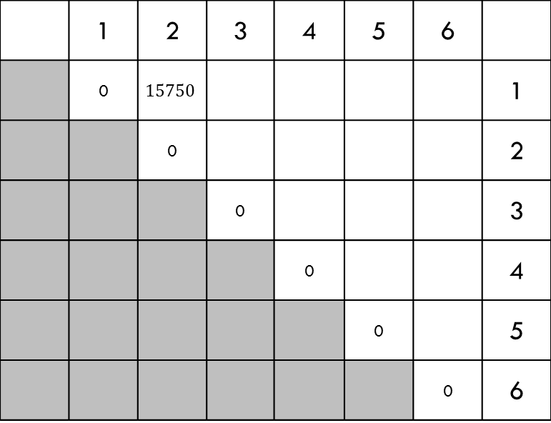
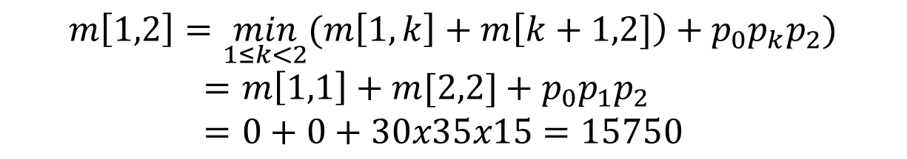

Example
Matrix | A1 | A2 | A3 | A4 | A5 | A6
Dimension | 30x35 | 35x15 | 15x5 | 5x10 | 10x20 | 20x25
$$i$$
 | 1 | 2 | 3 | 4 | 5 | 6
 | 0 | $$15750$$ |  |  |  |  | 1
 |  | 0 |  |  |  |  | 2
 |  |  | 0 |  |  |  | 3
 |  |  |  | 0 |  |  | 4
 |  |  |  |  | 0 |  | 5
 |  |  |  |  |  | 0 | 6
$$j$$
$$m\left[1,2\right]=\min_{1≤k<2}{(m\left[1,k\right]+m\left[k+1,2]\right)+p_{0}p_{k}p_{2})}$$
$=m\left[1,1\right]+m[2,2]+p_{0}p_{1}p_{2}$
$=0+0+30x35x15=15750$

Slide 18

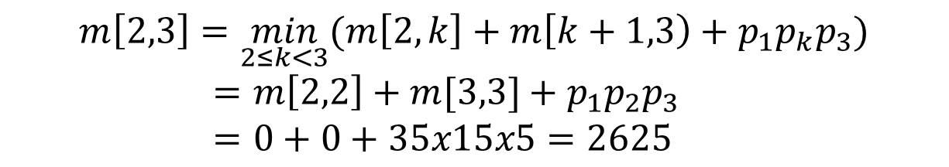
Example
Matrix | A1 | A2 | A3 | A4 | A5 | A6
Dimension | 30x35 | 35x15 | 15x5 | 5x10 | 10x20 | 20x25
$$i$$
 | 1 | 2 | 3 | 4 | 5 | 6
 | 0 | $$15750$$ |  |  |  |  | 1
 |  | 0 | $$2625$$ |  |  |  | 2
 |  |  | 0 |  |  |  | 3
 |  |  |  | 0 |  |  | 4
 |  |  |  |  | 0 |  | 5
 |  |  |  |  |  | 0 | 6
$$j$$
$$m\left[2,3\right]=\min_{2≤k<3}{(m\left[2,k\right]+m\left[k+1,3\right)+p_{1}p_{k}p_{3})}$$
$=m\left[2,2\right]+m[3,3]+p_{1}p_{2}p_{3}$
$=0+0+35x15x5=2625$

Slide 19
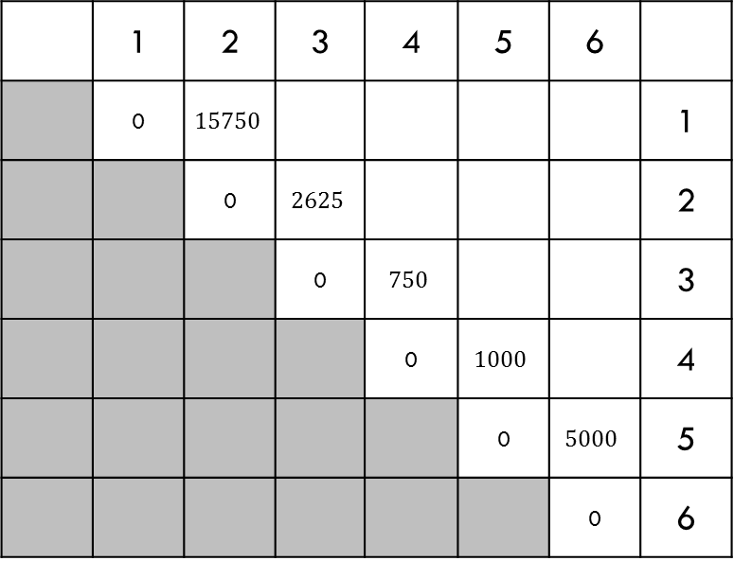
Example
Matrix | A1 | A2 | A3 | A4 | A5 | A6
Dimension | 30x35 | 35x15 | 15x5 | 5x10 | 10x20 | 20x25
$$i$$
 | 1 | 2 | 3 | 4 | 5 | 6
 | 0 | $$15750$$ |  |  |  |  | 1
 |  | 0 | $$2625$$ |  |  |  | 2
 |  |  | 0 | $$750$$ |  |  | 3
 |  |  |  | 0 | $$1000$$ |  | 4
 |  |  |  |  | 0 | $$5000$$ | 5
 |  |  |  |  |  | 0 | 6
$$j$$
Similarly, $m[3,4],m[4,5],m[5,6]$

Slide 20
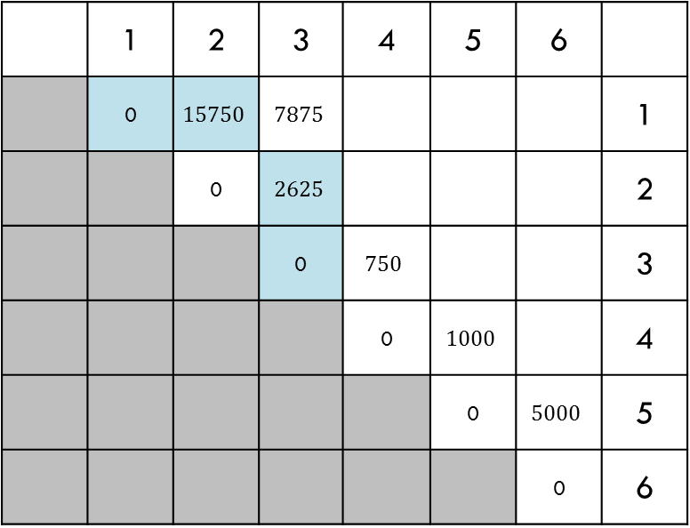
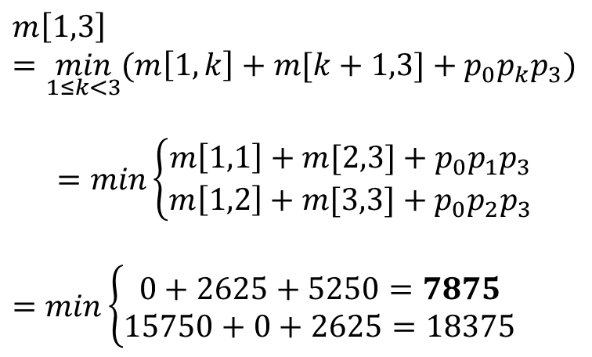
Example
Matrix | A1 | A2 | A3 | A4 | A5 | A6
Dimension | 30x35 | 35x15 | 15x5 | 5x10 | 10x20 | 20x25
$$m\left[1,3\right]=\min_{1≤k<3}{(m\left[1,k\right]+m[k+1,3]+p_{0}p_{k}p_{3})}$$
$$=min\left\{\begin{aligned}m\left[1,1\right]+m[2,3]+p_{0}p_{1}p_{3} \\ m\left[1,2\right]+m[3,3]+p_{0}p_{2}p_{3}\end{aligned}\right.$$
$=$ $min\left\{\begin{aligned}0+2625+5250=7875 \\ 15750+0+2625=18375\end{aligned}\right.$
$$j$$
$$i$$
 | 1 | 2 | 3 | 4 | 5 | 6
 | 0 | $$15750$$ | $$7875$$ |  |  |  | 1
 |  | 0 | $$2625$$ |  |  |  | 2
 |  |  | 0 | $$750$$ |  |  | 3
 |  |  |  | 0 | $$1000$$ |  | 4
 |  |  |  |  | 0 | $$5000$$ | 5
 |  |  |  |  |  | 0 | 6

Slide 21

Example
Matrix | A1 | A2 | A3 | A4 | A5 | A6
Dimension | 30x35 | 35x15 | 15x5 | 5x10 | 10x20 | 20x25
$$i$$
 | 1 | 2 | 3 | 4 | 5 | 6
 | 0 | $$15750$$ | $$7875$$ |  |  |  | 1
 |  | 0 | $$2625$$ | $$4375$$ |  |  | 2
 |  |  | 0 | $$750$$ | $$2500$$ |  | 3
 |  |  |  | 0 | $$1000$$ | $$3500$$ | 4
 |  |  |  |  | 0 | $$5000$$ | 5
 |  |  |  |  |  | 0 | 6
$$j$$
Similarly, $m[2,4], m[3,5], m[4,6]$

Slide 22

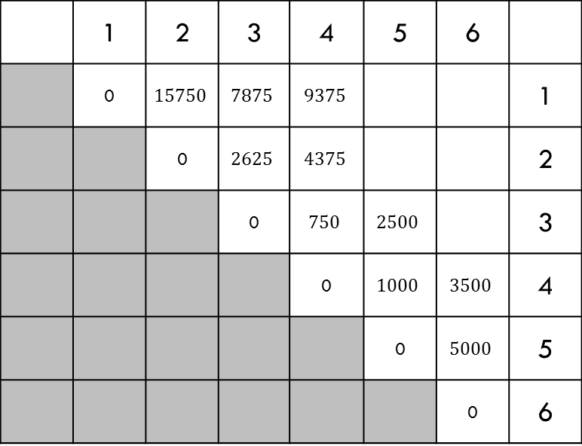
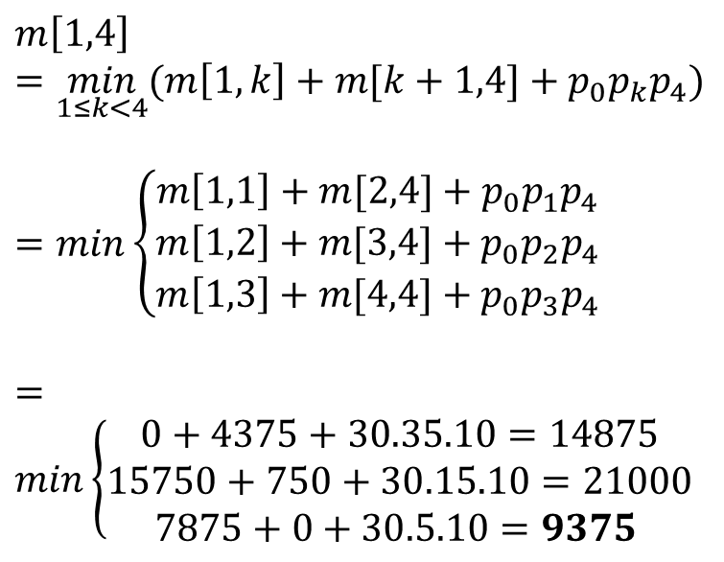

Example
Matrix | A1 | A2 | A3 | A4 | A5 | A6
Dimension | 30x35 | 35x15 | 15x5 | 5x10 | 10x20 | 20x25
$$j$$
$$i$$
 | 1 | 2 | 3 | 4 | 5 | 6
 | 0 | $$15750$$ | $$7875$$ | $$9375$$ |  |  | 1
 |  | 0 | $$2625$$ | $$4375$$ |  |  | 2
 |  |  | 0 | $$750$$ | $$2500$$ |  | 3
 |  |  |  | 0 | $$1000$$ | $$3500$$ | 4
 |  |  |  |  | 0 | $$5000$$ | 5
 |  |  |  |  |  | 0 | 6
$$m\left[1,4\right]=\min_{1≤k<4}{(m\left[1,k\right]+m[k+1,4]+p_{0}p_{k}p_{4})}$$
$=min\left\{\begin{aligned}m\left[1,1\right]+m[2,4]+p_{0}p_{1}p_{4} \\ m\left[1,2\right]+m[3,4]+p_{0}p_{2}p_{4} \\ m\left[1,3\right]+m[4,4]+p_{0}p_{3}p_{4}\end{aligned}\right.$
$=min\left\{\begin{aligned}0+4375+30.35.10=14875 \\ 15750+750+30.15.10=21000 \\ 7875+0+30.5.10=9375 \end{aligned}\right.$

Slide 23
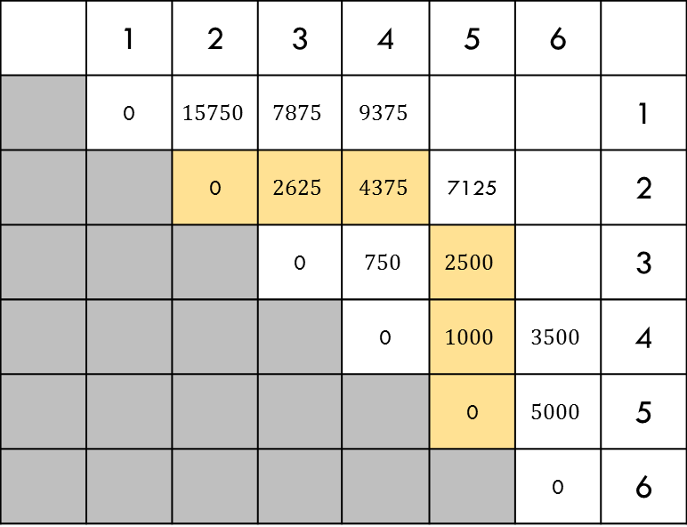
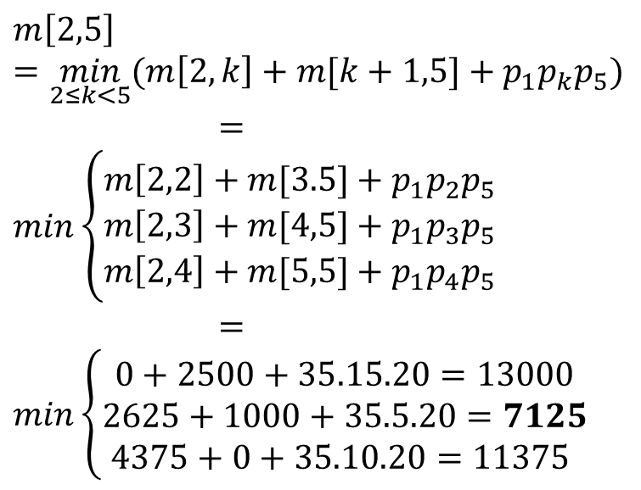
Example
Matrix | A1 | A2 | A3 | A4 | A5 | A6
Dimension | 30x35 | 35x15 | 15x5 | 5x10 | 10x20 | 20x25
$$j$$
$$i$$
 | 1 | 2 | 3 | 4 | 5 | 6
 | 0 | $$15750$$ | $$7875$$ | $$9375$$ |  |  | 1
 |  | 0 | $$2625$$ | $$4375$$ | 7125 |  | 2
 |  |  | 0 | $$750$$ | $$2500$$ |  | 3
 |  |  |  | 0 | $$1000$$ | $$3500$$ | 4
 |  |  |  |  | 0 | $$5000$$ | 5
 |  |  |  |  |  | 0 | 6
$$m\left[2,5\right]=\min_{2≤k<5}{(m\left[2,k\right]+m[k+1,5]+p_{1}p_{k}p_{5})}$$
$=min\left\{\begin{aligned}m\left[2,2\right]+m[3.5]+p_{1}p_{2}p_{5} \\ m\left[2,3\right]+m[4,5]+p_{1}p_{3}p_{5} \\ m\left[2,4\right]+m[5,5]+p_{1}p_{4}p_{5}\end{aligned}\right.$
$=min\left\{\begin{aligned}0+2500+35.15.20=13000 \\ 2625+1000+35.5.20=7125 \\ 4375+0+35.10.20=11375 \end{aligned}\right.$

Slide 24

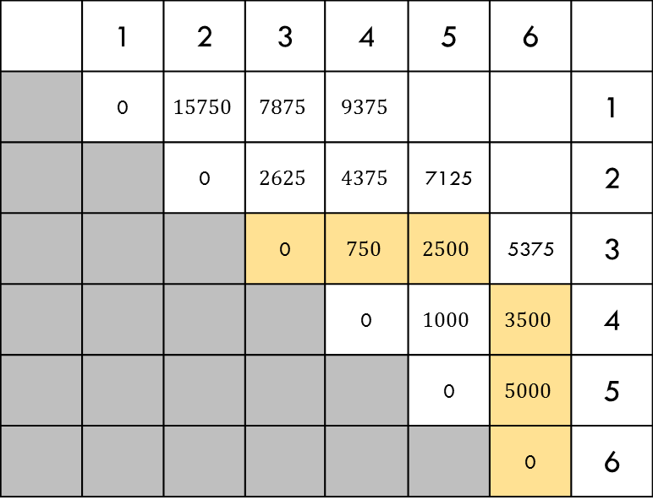


Example
Matrix | A1 | A2 | A3 | A4 | A5 | A6
Dimension | 30x35 | 35x15 | 15x5 | 5x10 | 10x20 | 20x25
$$j$$
$$i$$
 | 1 | 2 | 3 | 4 | 5 | 6
 | 0 | $$15750$$ | $$7875$$ | $$9375$$ |  |  | 1
 |  | 0 | $$2625$$ | $$4375$$ | 7125 |  | 2
 |  |  | 0 | $$750$$ | $$2500$$ | 5375 | 3
 |  |  |  | 0 | $$1000$$ | $$3500$$ | 4
 |  |  |  |  | 0 | $$5000$$ | 5
 |  |  |  |  |  | 0 | 6
Similarly, $m[3,6]$

Slide 25
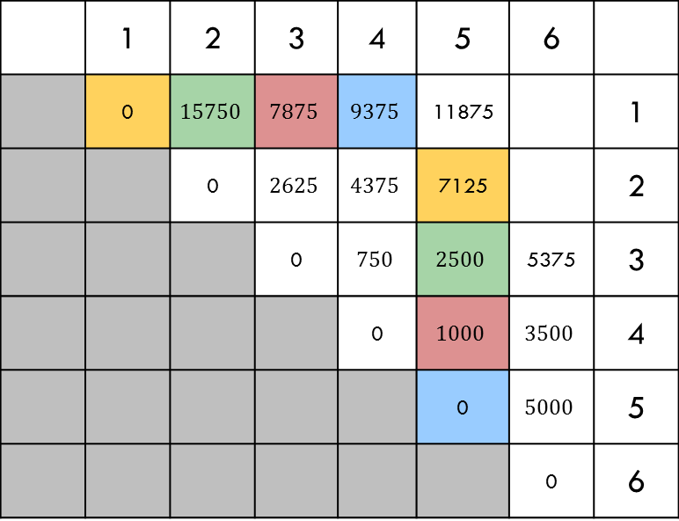
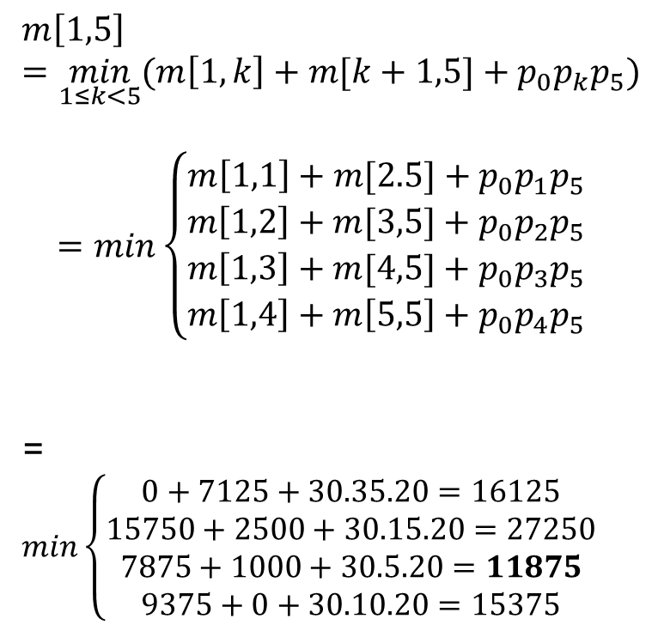
Example
Matrix | A1 | A2 | A3 | A4 | A5 | A6
Dimension | 30x35 | 35x15 | 15x5 | 5x10 | 10x20 | 20x25
$$j$$
$$i$$
 | 1 | 2 | 3 | 4 | 5 | 6
 | 0 | $$15750$$ | $$7875$$ | $$9375$$ | 11875 |  | 1
 |  | 0 | $$2625$$ | $$4375$$ | 7125 |  | 2
 |  |  | 0 | $$750$$ | $$2500$$ | 5375 | 3
 |  |  |  | 0 | $$1000$$ | $$3500$$ | 4
 |  |  |  |  | 0 | $$5000$$ | 5
 |  |  |  |  |  | 0 | 6
$$m\left[1,5\right]=\min_{1≤k<5}{(m\left[1,k\right]+m[k+1,5]+p_{0}p_{k}p_{5})}$$
$$=min\left\{\begin{aligned}m\left[1,1\right]+m[2.5]+p_{0}p_{1}p_{5} \\ m\left[1,2\right]+m[3,5]+p_{0}p_{2}p_{5} \\ m\left[1,3\right]+m[4,5]+p_{0}p_{3}p_{5} \\ m\left[1,4\right]+m\left[5,5\right]+p_{0}p_{4}p_{5}\end{aligned}\right.$$
= $min\left\{\begin{aligned}0+7125+30.35.20=16125 \\ 15750+2500+30.15.20=27250 \\ 7875+1000+30.5.20=11875 \\ 9375+0+30.10.20=15375\end{aligned}\right.$

Slide 26

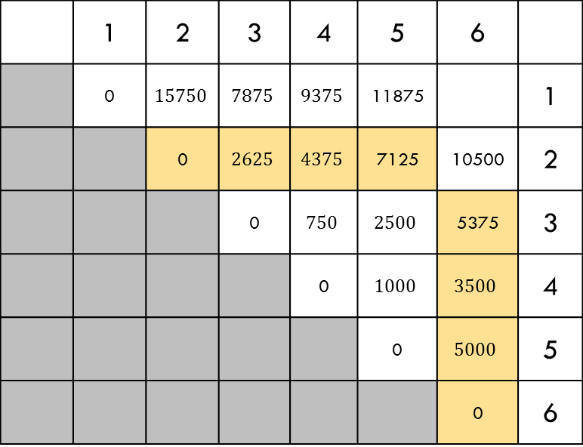


Example
Matrix | A1 | A2 | A3 | A4 | A5 | A6
Dimension | 30x35 | 35x15 | 15x5 | 5x10 | 10x20 | 20x25
$$j$$
$$i$$
 | 1 | 2 | 3 | 4 | 5 | 6
 | 0 | $$15750$$ | $$7875$$ | $$9375$$ | 11875 |  | 1
 |  | 0 | $$2625$$ | $$4375$$ | 7125 | 10500 | 2
 |  |  | 0 | $$750$$ | $$2500$$ | 5375 | 3
 |  |  |  | 0 | $$1000$$ | $$3500$$ | 4
 |  |  |  |  | 0 | $$5000$$ | 5
 |  |  |  |  |  | 0 | 6
Similarly, $m\left[2,6\right],$

Slide 27
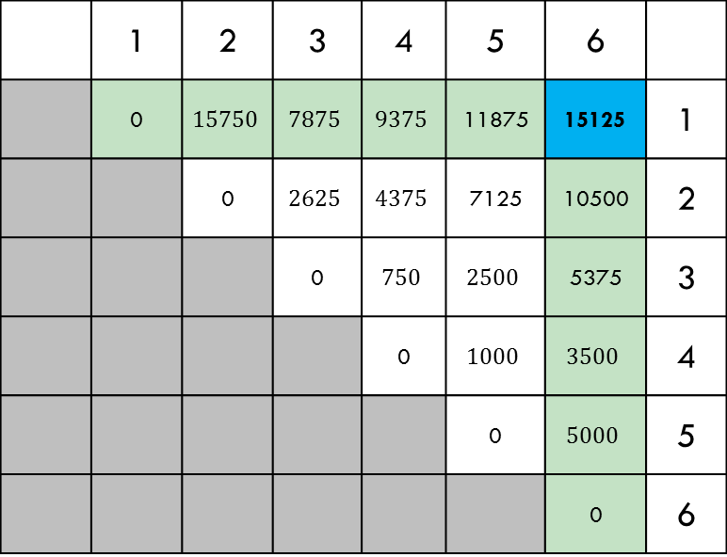

Example
Matrix | A1 | A2 | A3 | A4 | A5 | A6
Dimension | 30x35 | 35x15 | 15x5 | 5x10 | 10x20 | 20x25
$$j$$
$$i$$
 | 1 | 2 | 3 | 4 | 5 | 6
 | 0 | $$15750$$ | $$7875$$ | $$9375$$ | 11875 | 15125 | 1
 |  | 0 | $$2625$$ | $$4375$$ | 7125 | 10500 | 2
 |  |  | 0 | $$750$$ | $$2500$$ | 5375 | 3
 |  |  |  | 0 | $$1000$$ | $$3500$$ | 4
 |  |  |  |  | 0 | $$5000$$ | 5
 |  |  |  |  |  | 0 | 6
Similarly,$m[1,6]$

Slide 28






Example: Now keep tracking of split index
$$j$$
$$i$$
 | 1 | 2 | 3 | 4 | 5 | 6
 |  | 1 | 1 | 3 | 3 | 3 | 1
 |  |  | 2 | 3 | 3 | 3 | 2
 |  |  |  | 3 | 3 | 3 | 3
 |  |  |  |  | 4 | 5 | 4
 |  |  |  |  |  | 5 | 5
 |  |  |  |  |  |  | 6
($A1A2A3A4A5A6)$
($A1A2A3)(A4A5A6)$
($A1(A2A3))(A4A5A6)$
($A1(A2A3))((A4A5)A6)$

Slide 29
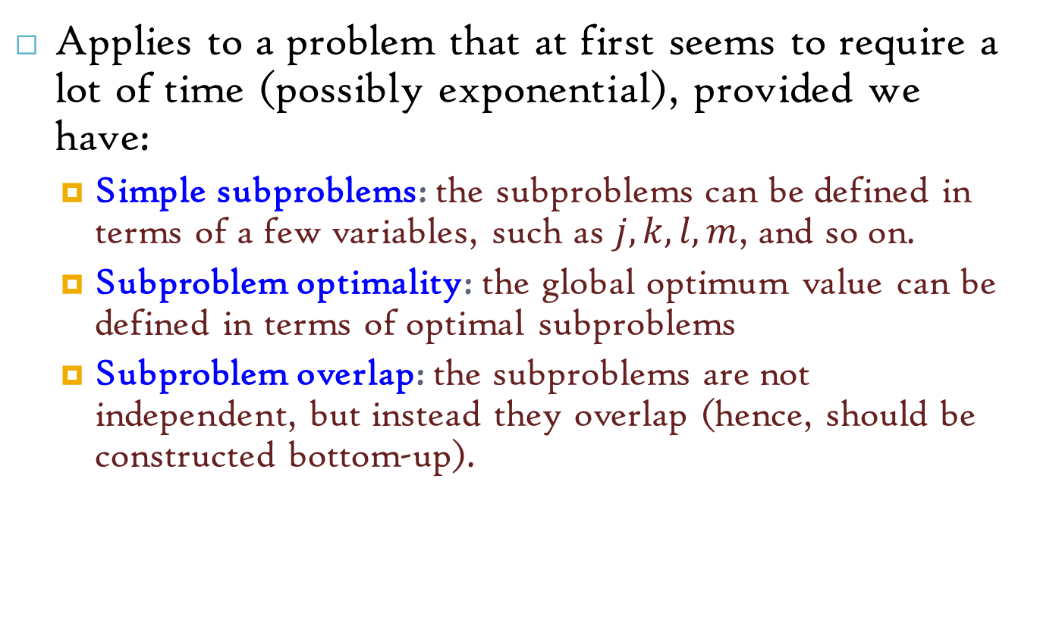
The General Dynamic Programming Technique
Applies to a problem that at first seems to require a lot of time (possibly exponential), provided we have:
Simple subproblems: the subproblems can be defined in terms of a few variables, such as $j, k, l, m$, and so on.
Subproblem optimality: the global optimum value can be defined in terms of optimal subproblems
Subproblem overlap: the subproblems are not independent, but instead they overlap (hence, should be constructed bottom-up).

Slide 30
Reference
Algorithm Design: Foundations, Analysis, and Internet Examples. Michael T. Goodrich and Roberto Tamassia. John Wiley & Sons.
Introduction to Algorithms. Thomas H. Cormen, Charles E. Leiserson, Ronald L. Rivest, Clifford Stein.

Slide 31
Thank you!

